Slide 1
Multiple Features
Linear Regression with multiple variables

Slide 2
Matrices and Vectors
Linear Algebra review

Slide 3
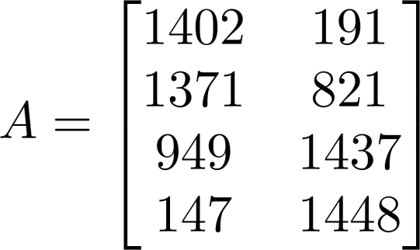
Matrix: Rectangular array of numbers:
Dimension of matrix: number of rows x number of columns

Slide 4




Matrix Elements (entries of matrix)
“ , entry” in the row, column.

Slide 5
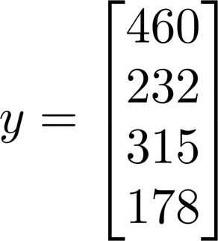
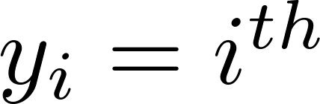
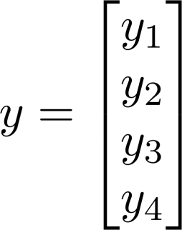
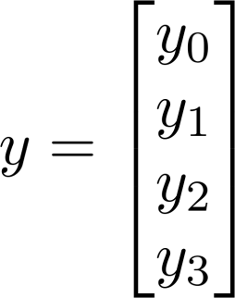
Vector: An n x 1 matrix.
1-indexed vs 0-indexed:
element
n-dimensional vector

Slide 6
Addition and Scalar Multiplication
Linear Algebra review

Slide 7
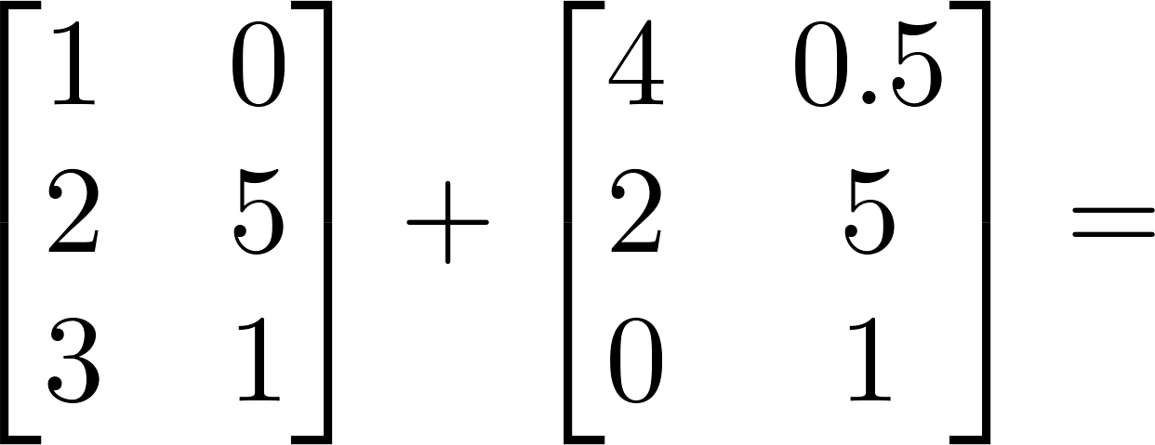
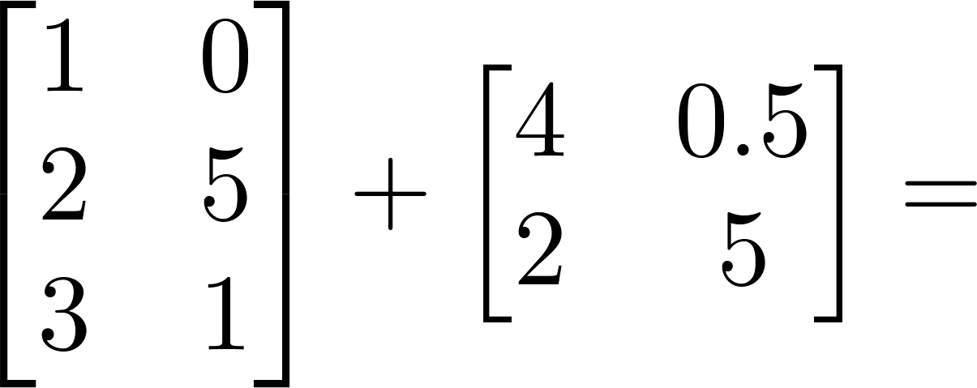
Matrix Addition

Slide 8
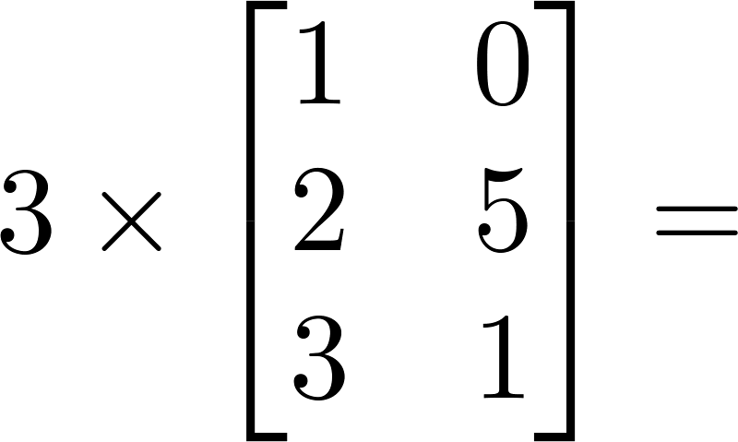
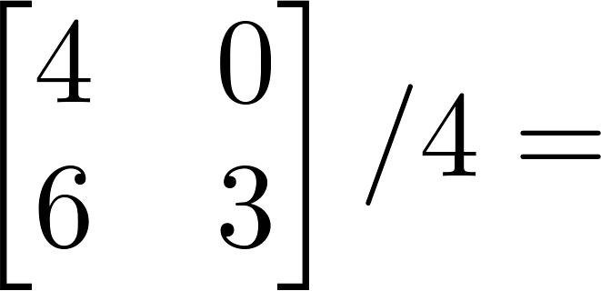
Scalar Multiplication

Slide 9
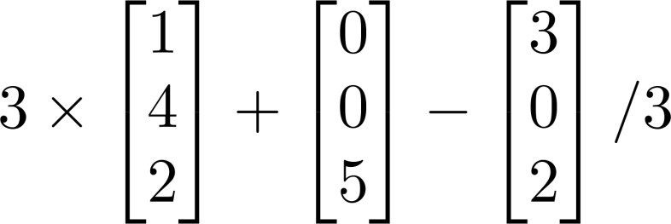
Combination of Operands

Slide 10
Matrix – Vector Multiplication
Linear Algebra review

Slide 11
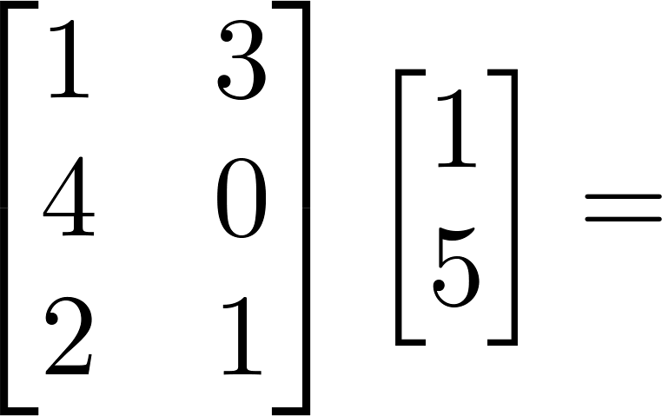
Example

Slide 12
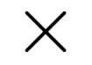
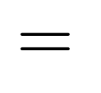



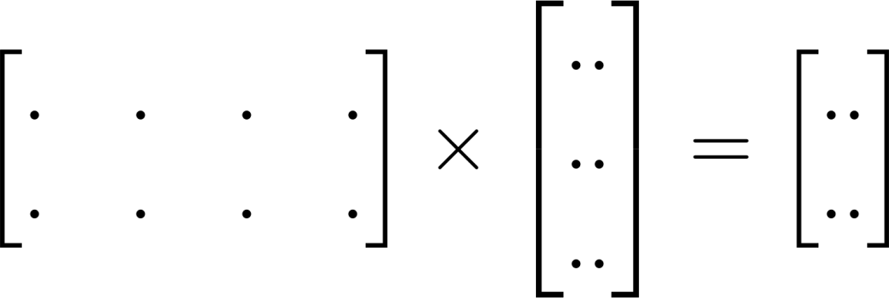
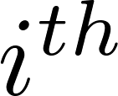

Details:
m x n matrix
(m rows,
n columns)
n x 1 matrix
(n-dimensional
vector)
m-dimensional vector
To get , multiply ’s row with elements of vector , and add them up.

Slide 13
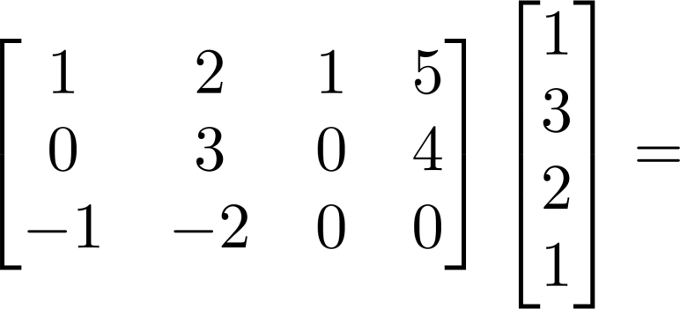
Example

Slide 14
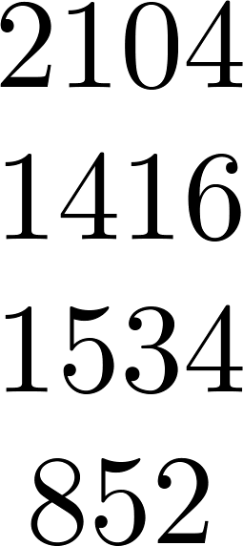
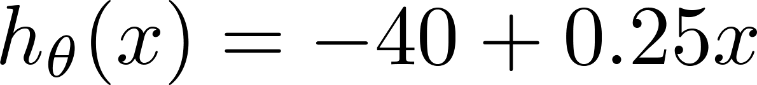
House sizes:

Slide 15
Matrix – Matrix Multiplication
Linear Algebra review

Slide 16
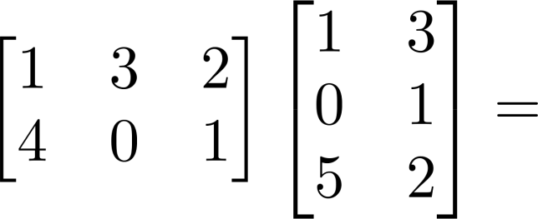
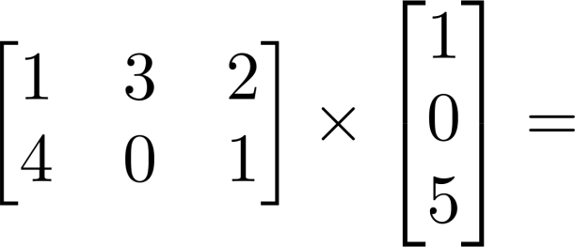
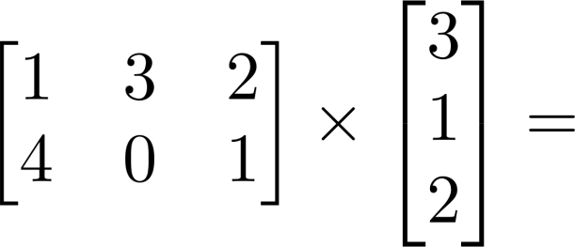
Example

Slide 17


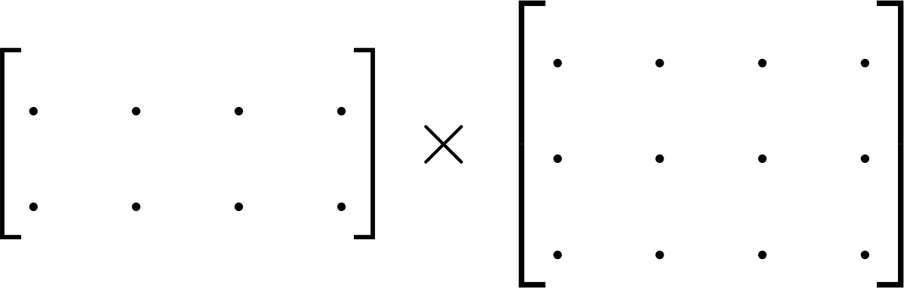
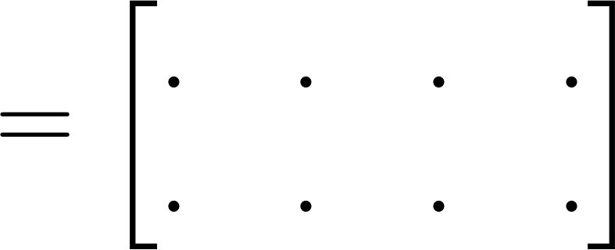

Details:
m x n matrix
(m rows,
n columns)
n x o matrix
(n rows,
o columns)
m x o
matrix
The column of the matrix is obtained by multiplying
with the column of . (for = 1,2,…,o)

Slide 18
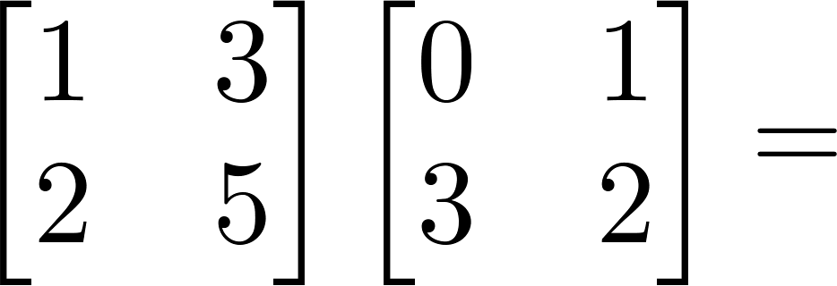
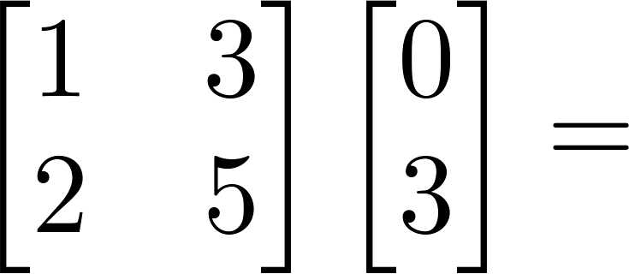
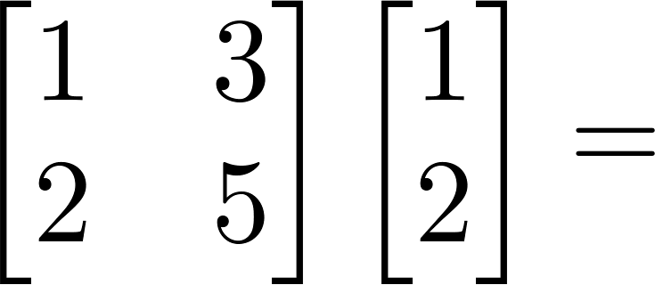
Example

Slide 19
House sizes:
hypotheses:
Prediction = Data Matrix * Parameters

Slide 20
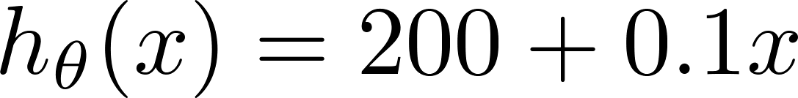
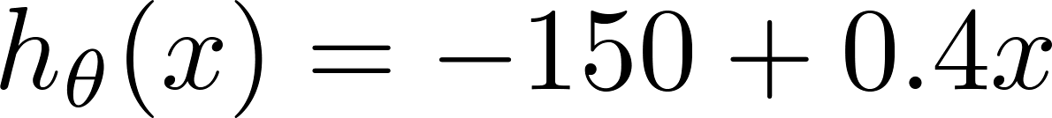
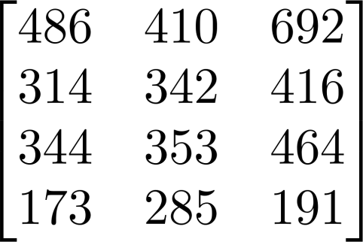
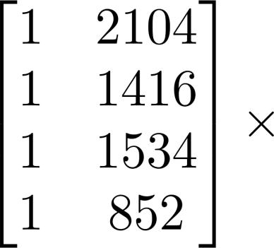
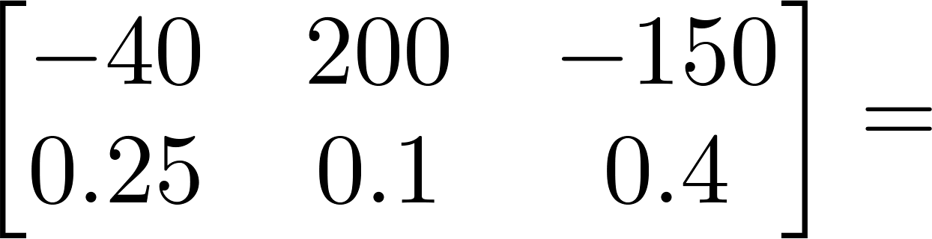
House sizes:
Have 3 competing hypotheses:
1.
2.
3.
Matrix
Matrix

Slide 21
Matrix Multiplication Properties
Linear Algebra review

Slide 22

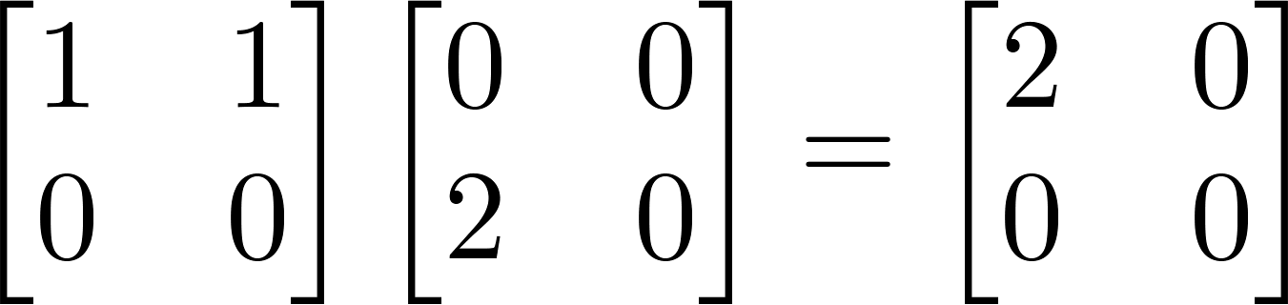
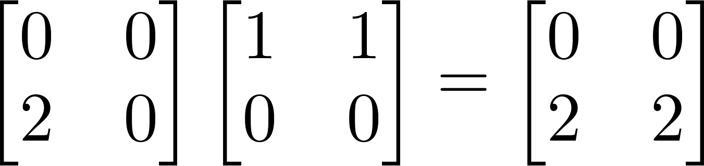
Let and be matrices. Then in general,
(not commutative.)
E.g.

Slide 23





Let
Compute
Let
Compute

Slide 24

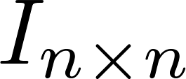
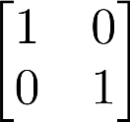
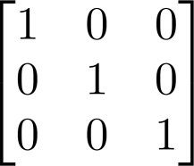
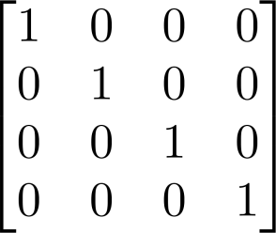
Identity Matrix
Denoted (or ).
Examples of identity matrices:
2 x 2
3 x 3
4 x 4
For any matrix ,

Slide 25
Inverse and Transpose
Linear Algebra review

Slide 26
Not all numbers have an inverse.
Matrix inverse:
If A is an m x m matrix, and if it has an inverse,
Matrices that don’t have an inverse are “singular” or “degenerate”

Slide 27
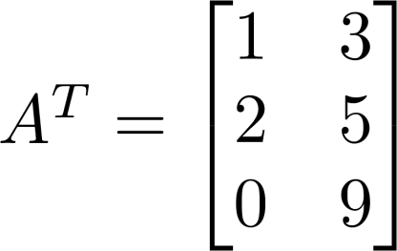
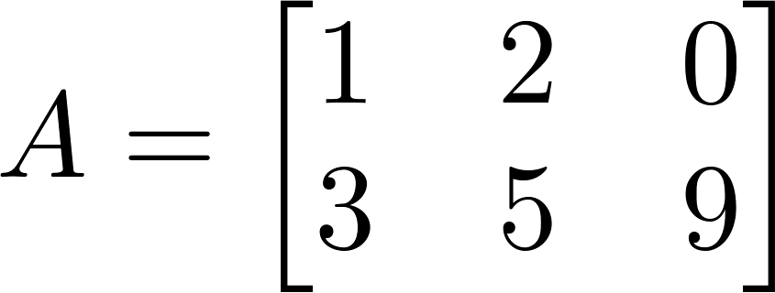

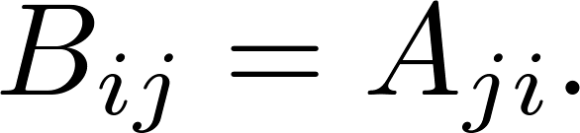
Matrix Transpose
Example:
Let be an m x n matrix, and let
Then is an n x m matrix, and

Slide 28
Multiple Features
Linear Regression with multiple variables

Slide 29


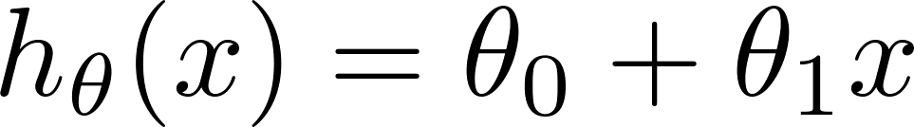
Multiple features (variables).
Size (feet²) | Price ($1000)
2104 | 460
1416 | 232
1534 | 315
852 | 178
… | …

Slide 30
Multiple features (variables).
Size (feet²) | Number of bedrooms | Number of floors | Age of home (years) | Price ($1000)
2104 | 5 | 1 | 45 | 460
1416 | 3 | 2 | 40 | 232
1534 | 3 | 2 | 30 | 315
852 | 2 | 1 | 36 | 178
… | … | … | … | …

Slide 31



Multiple features (variables).
Size (feet²) | Number of bedrooms | Number of floors | Age of home (years) | Price ($1000)
2104 | 5 | 1 | 45 | 460
1416 | 3 | 2 | 40 | 232
1534 | 3 | 2 | 30 | 315
852 | 2 | 1 | 36 | 178
… | … | … | … | …
Notation:
= number of features
= input (features) of training example.
= value of feature in training example.
Feature Vector X³?
Notes:
Pop-up Quiz

Slide 33
Hypothesis:
Previously:
Now: h_{θ}(x) = θ₀+ θ₁x₁+ θ₂x₂+ θ₃x₃+ θ₄x₄
Example: h_{θ}(x) = 100+ 0.1x₁+ 0.01x₂+ 3x₃ - 2x₄

Slide 34
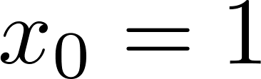

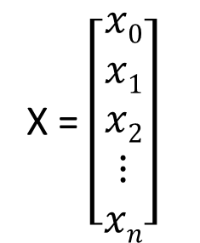

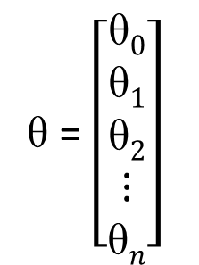
For convenience of notation, define .
X = $\left[\begin{aligned}x0 \\ x1 \\ x2 \\ ⋮ \\ xn\end{aligned}\right]$
θ = $\left[\begin{aligned}\text{θ}0 \\ \text{θ}1 \\ \text{θ}2 \\ ⋮ \\ \text{θ}n\end{aligned}\right]$
$$∈R n+1$$
$$∈R n+1$$
h_{θ}(x) = θ^{T}X
h_{θ}(x) = θ₀x₀+ θ₁x₁+ θ₂x₂+ ..... + θ_{n}x_{n}
Multivariate linear regression.

Slide 35
Gradient descent for multiple variables
Linear Regression with multiple variables

Slide 36
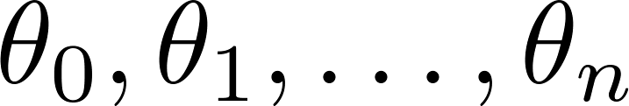
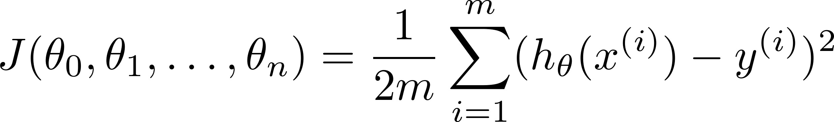
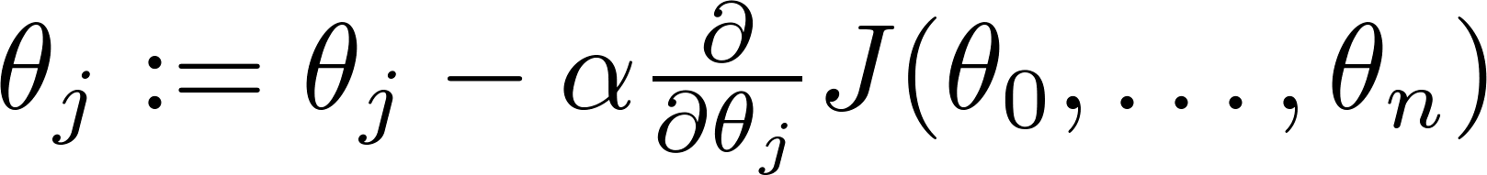

Hypothesis:
Parameters:
Cost function:
Gradient descent:
Repeat
(simultaneously update for every )

Slide 37

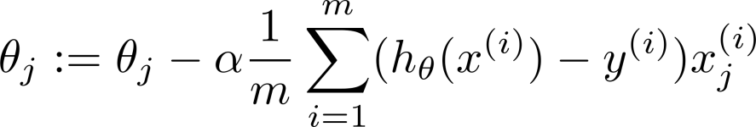
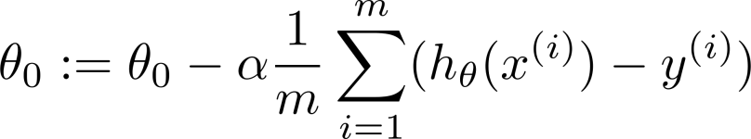



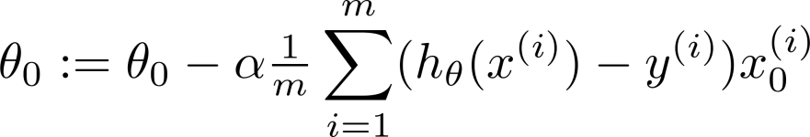




New algorithm :
Gradient Descent
Repeat
Previously (n=1):
Repeat
(simultaneously update for
)
(simultaneously update )

Slide 38
Feature Scaling (Practical Tricks to make Descent Algorithm works well)
Linear Regression with multiple variables

Slide 39







Feature Scaling
Idea: Make sure features are on a similar scale.
E.g. = size (0-2000 feet²)
= number of bedrooms (1-5)
size (feet²)
number of bedrooms

Slide 40

Feature Scaling
Get every feature into approximately a range.

Slide 41





Mean normalization
Replace with to make features have approximately zero mean (Do not apply to ).
E.g.

Slide 42
Learning Rate (Practical Tricks to make Descent Algorithm works well)
Linear Regression with multiple variables

Slide 43


Gradient descent
“Debugging”: How to make sure gradient descent is working correctly.
How to choose learning rate .

Slide 44


Making sure gradient descent is working correctly.
Example automatic convergence test:
Declare convergence if decreases by less than in one iteration.
No. of iterations

Slide 45


Making sure gradient descent is working correctly.
Gradient descent not working.
Use smaller .
No. of iterations
No. of iterations
No. of iterations
For sufficiently small , should decrease on every iteration.
But if is too small, gradient descent can be slow to converge.

Slide 46
Summary:
If is too small: slow convergence.
If is too large: may not decrease on every iteration; may not converge.
To choose , try

Slide 47
Features and Polynomial Regression
Linear Regression with multiple variables

Slide 48

Housing prices prediction

Slide 49





Polynomial regression
Price
(y)
Size (x)

Slide 50
Choice of features
Price
(y)
Size (x)

Slide 52
Normal Equation
Linear Regression with multiple variables

Slide 53

Gradient Descent
Normal equation: Method to solve for
analytically.

Slide 54






Intuition: If 1D
(for every )
Solve for

Slide 55









Examples:
 | Size (feet²) | Number of bedrooms | Number of floors | Age of home (years) | Price ($1000)
1 | 2104 | 5 | 1 | 45 | 460
1 | 1416 | 3 | 2 | 40 | 232
1 | 1534 | 3 | 2 | 30 | 315
1 | 852 | 2 | 1 | 36 | 178
Size (feet²) | Number of bedrooms | Number of floors | Age of home (years) | Price ($1000)
2104 | 5 | 1 | 45 | 460
1416 | 3 | 2 | 40 | 232
1534 | 3 | 2 | 30 | 315
852 | 2 | 1 | 36 | 178
Notes:
How to derive Normal Equation:
http://eli.thegreenplace.net/2014/derivation-of-the-normal-equation-for-linear-regression/

Slide 56




Examples:
 | Size (feet²) | Number of bedrooms | Number of floors | Age of home (years) | Price ($1000)
1 | 2104 | 5 | 1 | 45 | 460
1 | 1416 | 3 | 2 | 40 | 232
1 | 1534 | 3 | 2 | 30 | 315
1 | 852 | 2 | 1 | 36 | 178
1
Size (feet²) | Number of bedrooms | Number of floors | Age of home (years) | Price ($1000)
2104 | 5 | 1 | 45 | 460
1416 | 3 | 2 | 40 | 232
1534 | 3 | 2 | 30 | 315
852 | 2 | 1 | 36 | 178
3000 | 4 | 1 | 38 | 540
Notes:
How to Derive Normal Equation:
http://eli.thegreenplace.net/2014/derivation-of-the-normal-equation-for-linear-regression/

Slide 57





examples ; features.
E.g. If

Slide 58



is inverse of matrix .
Python:
import numpy as NP
x_transpose = NP.transpose(X)
NP.linalg.pinv(x_transpose*X)*x_transpose*y

Slide 59
training examples, features.
Gradient Descent
Normal Equation
Need to choose .
Needs many iterations.
No need to choose .
Don’t need to iterate.
Works well even when is large.
Need to compute
Slow if is very large.

